Slide 1


UNIT 2: Time for action
School uniforms

Slide 2
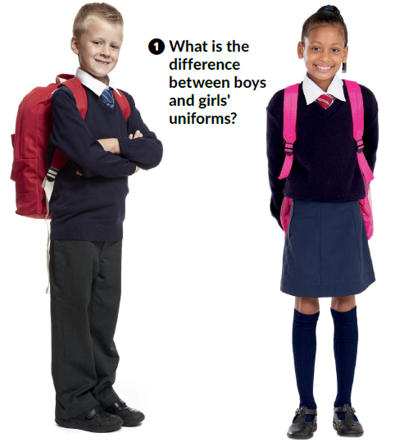
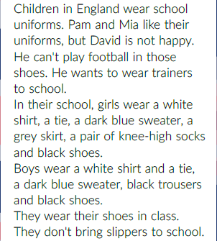
What do you wear in these places?
school
beach
mountains
home
party
Read the text and answer the question in task 1.
Open your book at page 43.
What are they wearing?

Slide 3
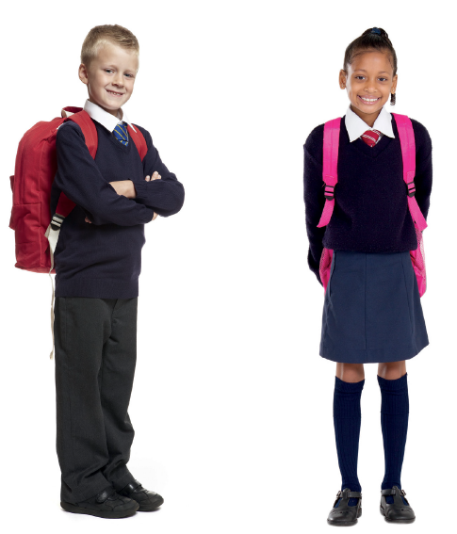
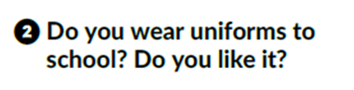
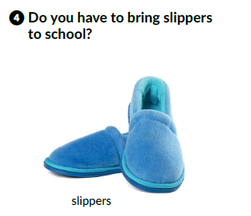

Slide 4
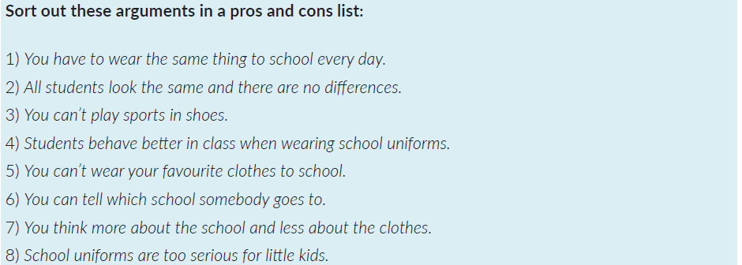

Work in groups.
What are the pros and cons of school uniforms?
The list below can help you.
Have a class discussion.

Slide 5

Click on the following link and choose Learn more.
Read one of the following texts:
A school with no subjects or Rules for teachers from the past.
Then, choose Self check. Complete the tasks.
https://www.e-sfera.hr/dodatni-digitalni-sadrzaji/9df9ef90-3b26-427d-961b-e5298791b4ea/

